Slide 1
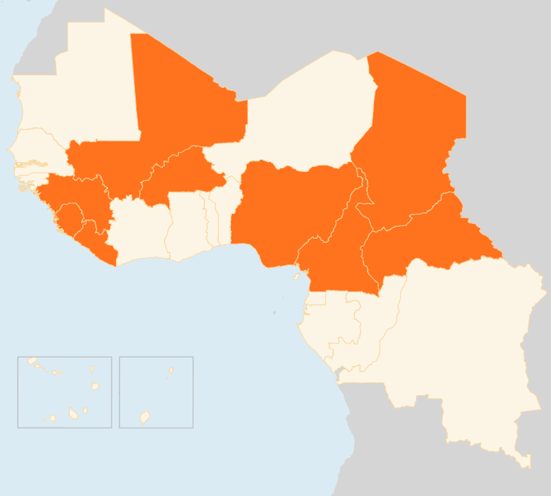


3 – 10 August 2015
BURKINA FASO
Flash floods in Central Region
Torrential rains triggered flash floods in the Central Region, flooding the Bissighin neighborhood in Ouagadougou and the village of Tanghin Dassouri, 30 km from the capital. Overall, some 1,240 houses were destroyed. Government and partners are providing assistance, primary needs including food and nutrition, health and sanitation. Authorities report that heavy rains and high winds this year so far have resulted in 3,669 people losing their homes and livelihoods.
CAMEROON
Several villages attacked
During the night of 3 - 4 August, suspected Boko Haram fighters attacked the village of Kangaleri, near the Nigerian border in the Far North region. About 20 people were killed and several children kidnapped. Another attack attributed to Boko Haram occurred in the village of Tchakamadje about 25 km north of Maroua. More than 100 people have been injured following recent attacks. Health services in the region lack adequate resources to deal with the situation.
CENTRAL AFRICAN REPUBLIC (CAR)
600 refugees return to DRC
On 4 August, UNHCR launched an airlift to repatriate more than 600 refugees to DRC six years after they fled to CAR. The refugees opted to be repatriated due to persisting insecurity in CAR. Upon arrival, the returnees will receive a grant to cover travel to their respective villages and facilitate their reintegration.
CHAD
10,000 new IDPs around Lake Chad
Thousands of people continue fleeing their villages in the Lake Chad region in fear of attacks. Many are sleeping under makeshift shelters with insufficient food or any basic services. The total number of Chadian IDPs in the Lake region has now reached more than 40,000 people. The registration is ongoing, and humanitarian partners are providing non-food items, WASH and food supplies in the three sites of Kafia, Dar Al Nahim and Kousseri.
MALI
13 killed in hotel attack
An attack in Sevare, near Mopti, on 7 August, targeting security forces and a local hotel often used by foreigners and UN contractors, resulted in 13 dead and several more injured. Four workers associated to the UN peacekeeping mission in Mali, MINUSMA, were killed and four rescued after hiding during the siege, according to MINUSMA.
Floodings in Menaka
Heavy rains on 7-8 August in Ménaka, Gao region, resulted in flooding causing five deaths and affecting 1,000 people, of which 750 took shelter in nearby schools. WASH materials and food have been distributed to those in need. Additional materials have been pre-positioned in the area should more flooding occur.
NIGERIA
12,000 returning from Cameroon received by NEMA
About 12,000 Nigerians returning from Cameroon and stranded at the Nigeria/Cameroon border in Adamawa state, are in urgent need of further assistance. The National Emergency Management Agency (NEMA) reported that 650 people have already been transported to Borno State. NEMA is providing food, non-food items, and medical support.
EVD REGIONAL
Three confirmed cases in Guinea and Sierra Leone
Last week, a total of three confirmed Ebola cases were reported: two in Guinea and one in Sierra Leone. Liberia reported no new cases and is closing in toward the 42 days without a new case to be declared Ebola-free.
MALI
CHAD
13
KILLED IN HOTEL ATTACK
10k
NEW IDPs AROUND LAKE CHAD
NIGERIA
12k
RETURNING FROM CAMEROON RECEIVED BY NEMA
CAR
600
REFUGEES RETURN TO DRC
EVD REGIONAL
CAMEROON
BURKINA FASO
SEVERAL VILLAGES ATTACKED
3
CASES IN GUINEA AND SIERRA LEONE
FLASH FLOODS IN CENTRAL REGION
Creation date: 13 August 2015
Map data sources: UNCS, DevInfo, OCHA.
The boundaries and names shown and the designations used on this map do not imply official endorsement or acceptance by the United Nations

